Slide 1
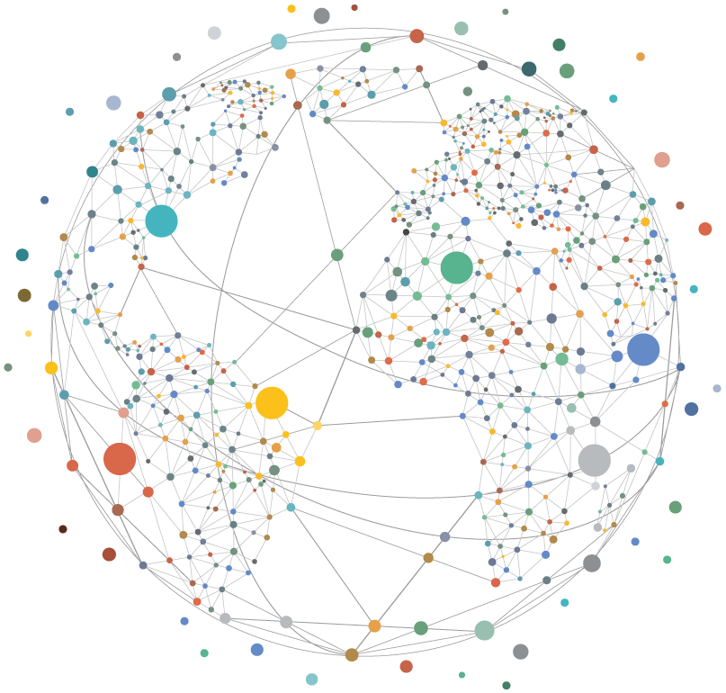
A Breakthrough for People and Planet
Effective and Inclusive Global Governance for Today and the Future

Slide 2
The Six Transformative Shifts
Rebuild Trust in Multilateralism
Plant and People
Global Finance
Digital and Data Governance
Peace and Prevention
Anticipatory Action
Improve Legitimacy and Effectiveness Through Inclusion and Accountability
Regain Balance with Nature and Provide Clean Energy for All
Ensure Sustainable Finance that Delivers for All
Support a Just Digital Transition that Unlocks the Value of Data and Protects Against Digital Harms
Empower Equitable, Effective Collective Security Arrangements
Strengthen Governance for Current and Emerging Transnational Risks

Slide 3
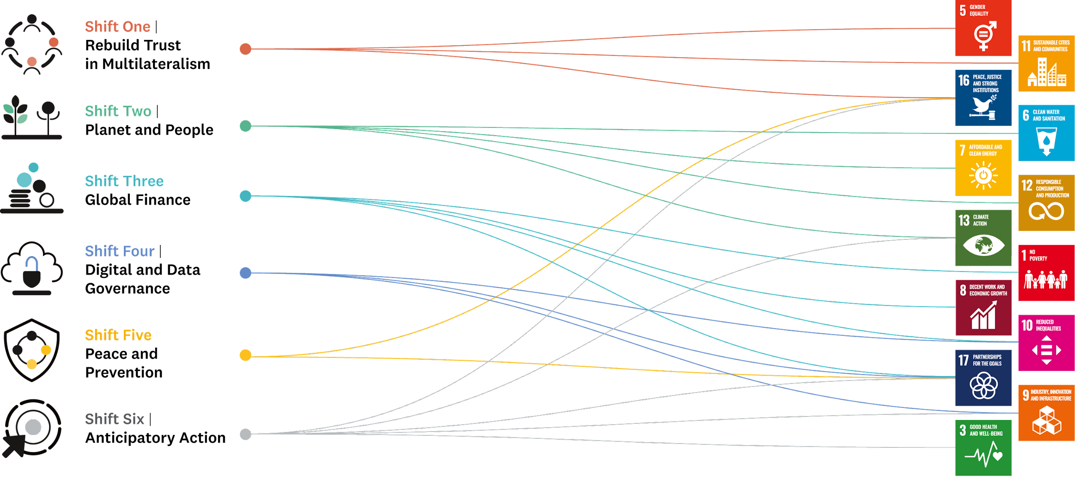
Alignment with the SDGs

Slide 4
Shift 1: Rebuild Trust in Multilateralism
Inclusive, effective multilateralism requires a fundamental transformation towards more distributed, networked & accountable decision-making for our collective well-being.
Recommendations:
Represent “we the peoples” in the multilateral system
Meaningful inclusion of cities and regions
Include & obligate the private sector
Innovations for more effective decision-making.

Slide 5
Principles of Effective Multilateralism
PEOPLE-CENTRED
REPRESENTATIVE
TRANSPARENT
EQUITABLE
NETWORKED
RESOURCED
MISSION-FOCUSED
FLEXIBLE
ACCOUNTABLE
FUTURE-ORIENTED

Slide 6
Shift 2: Planet and People
To flourish as a species, we must regain balance with nature & with one another, treating ecosystems as a primary asset for securing our collective well-being.
Recommendations:
Conclude a pact for people & planet
Equitably distribute clean energy
Price & regulate carbon for a just, green transition
Elevate the environment within the multilateral system.

Slide 7
Shift 3: Global Finance
A rapid, sizeable increase in long-term investment for people & planet will reduce inequalities and safeguard our shared life support systems.
Recommendations:
Repurpose the Multilateral Development Bank system
Strengthen the Global Financial Safety Net
Ensure greater automaticity & fairness in SDR allocations
Enact governance changes at the World Bank and IMF
Strengthen the global debt architecture
Facilitate regulatory frameworks for financial flows
Pursue global taxation reforms.

Slide 8
Shift 4: Digital and Data Governance
The solutions developed over the next few critical years will shape societies for decades to come. Our solutions must be human-centered & rights-respecting; encourage open dialogue, exchange & learning between cultures & sectors; & build on past successes.
Recommendations:
Support a just digital transition by addressing digital poverty, inequality & harms.
Lay the foundations of an enabling architecture for the data century.

Slide 9
Shift 5: Peace and Prevention
Evolving our global governance arrangements can more effectively and legitimately address the broad range of risks to our collective security.
Recommendations:
Commit to our collective security
Reform Security Council, strengthen Peacebuilding Commission
Collective security frameworks between UN & regional orgs
Increase transparency on peace & security
Strengthen & accelerate denuclearization.

Slide 10
Shift 6: Anticipatory Action
We need to position the multilateral system to more nimbly and effectively respond to emerging threats & act quickly and decisively in situations of uncertainty.
Recommendations:
Broaden understanding of & responses to the security risks posed by climate change
Governance of biological & health risks
Safe, effective management of emerging technologies
Combat transnational organized crime.

